Slide 1
Patent war dynamics Week 2. Data filterting and network construction
Valo Hallman, Jenny-Rosa Mattila, Stanislav Andreev

Slide 2

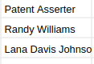
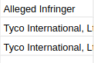
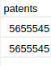
What does the data look like
~100 000 cases between 2000-2021
Who Sues who on what

Slide 3
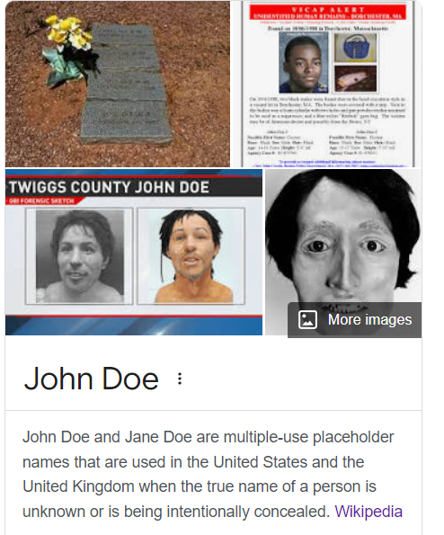

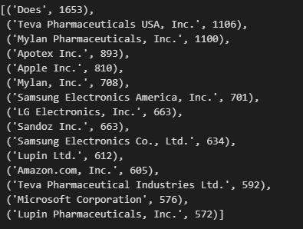
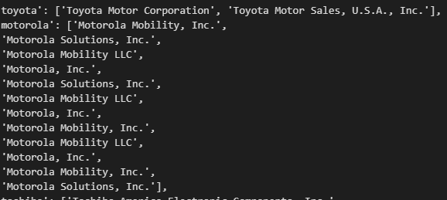
Problems with the data
Different names of the same company
Human errors (typos, different format, abbreviations)

Slide 4
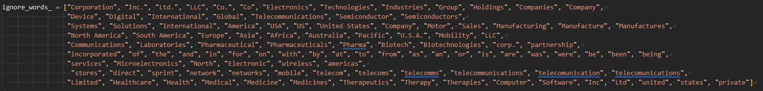



Merge possible duplicates (asserters and alleged infringers)
Filtering algorithm
1. Find the most frequent terms
2. Filter out technical parts (like
3. Make pairwise distance between terms with the help of special packages (fuzzywuzzy in python)
4. Merge connected (distance < threshold) terms and assign the same alias for all of them.
5. Iterate over all terms and find matches with aliases from 4.
6. Filter out all asserters and alleged infringers with number of cases less than threshold (e.g. 3)
jupyter notebook with the code

Slide 5
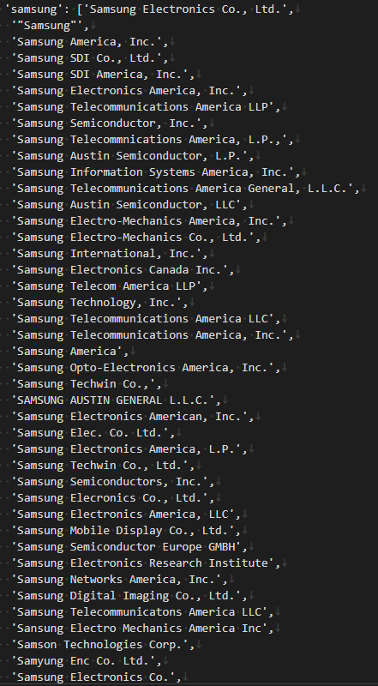
Construct network
Node – company/individual (alias from map produced in the previous step)
Directed edge reflects asserted case. Weight – number of cases.
We use only active asserters/infringers (filtering by threshold)
To track dynamics over years we splited data into chunks related to
3 year periods.

Slide 6
Visualization
To simplify the plot we showed only nodes with degree more than some threshold (it was increased for later years)
Reciprocated edges are especially interesting for us (if companies made cases against each other), so we highlighted them in red color.
To reflect 2 possible sides of patent war we used spring_layout from networkx, which utilizes Fruchterman-Reingold force-directed algorithm. Nodes imitated repelling objects (called an anti-gravity force)*. In our model central nodes are usually produce the cases against border nodes.
https://networkx.org/documentation/stable/reference/generated/networkx.drawing.layout.spring_layout.html

Slide 7
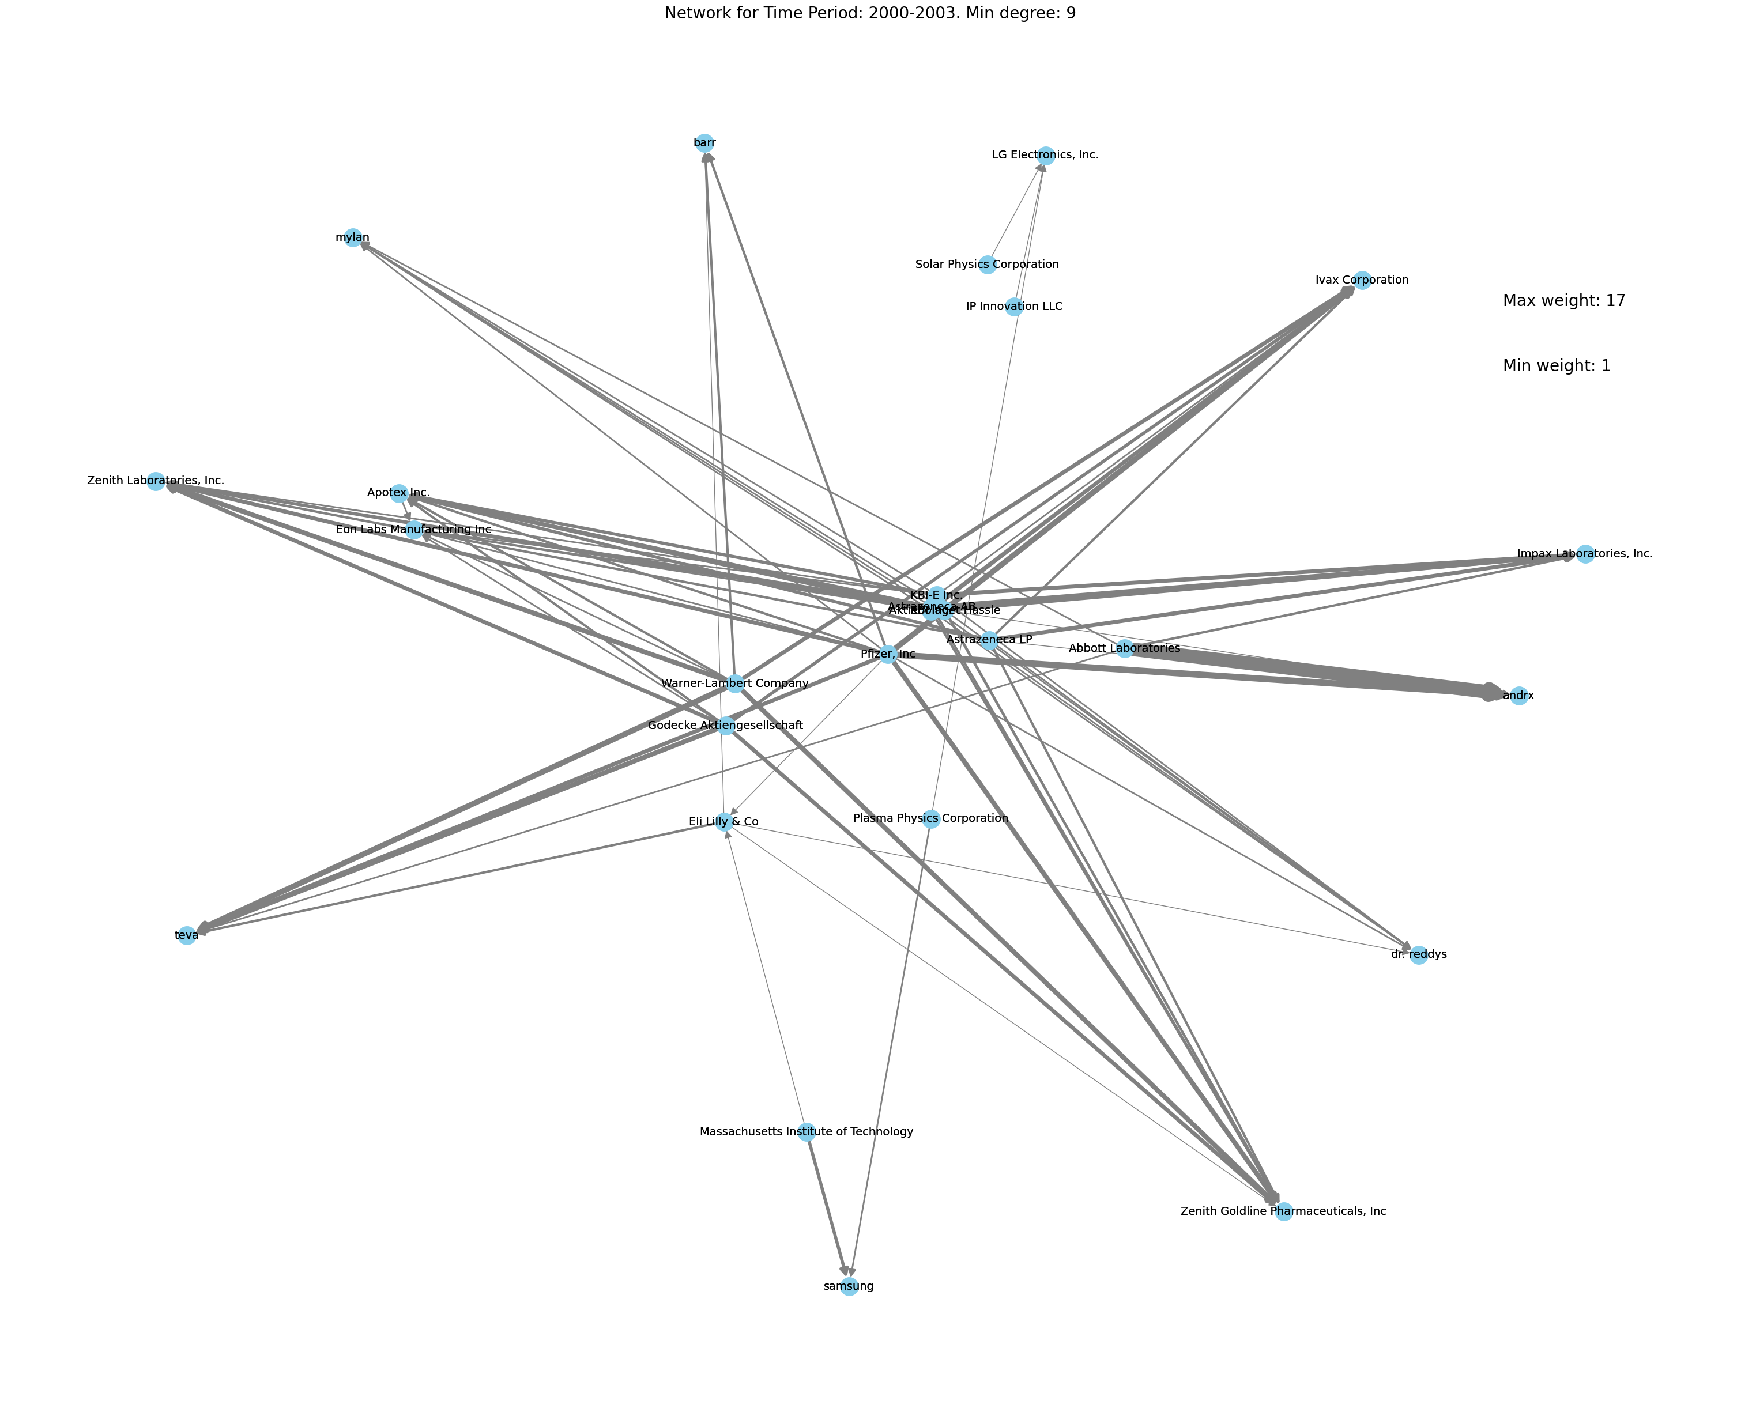
Visualization
We can distinguish 2 clusters:
pharma
small technology/electronics cluster
Some Institutes/law companies connect clusters
Jupyter notebook with the code and plots

Slide 8
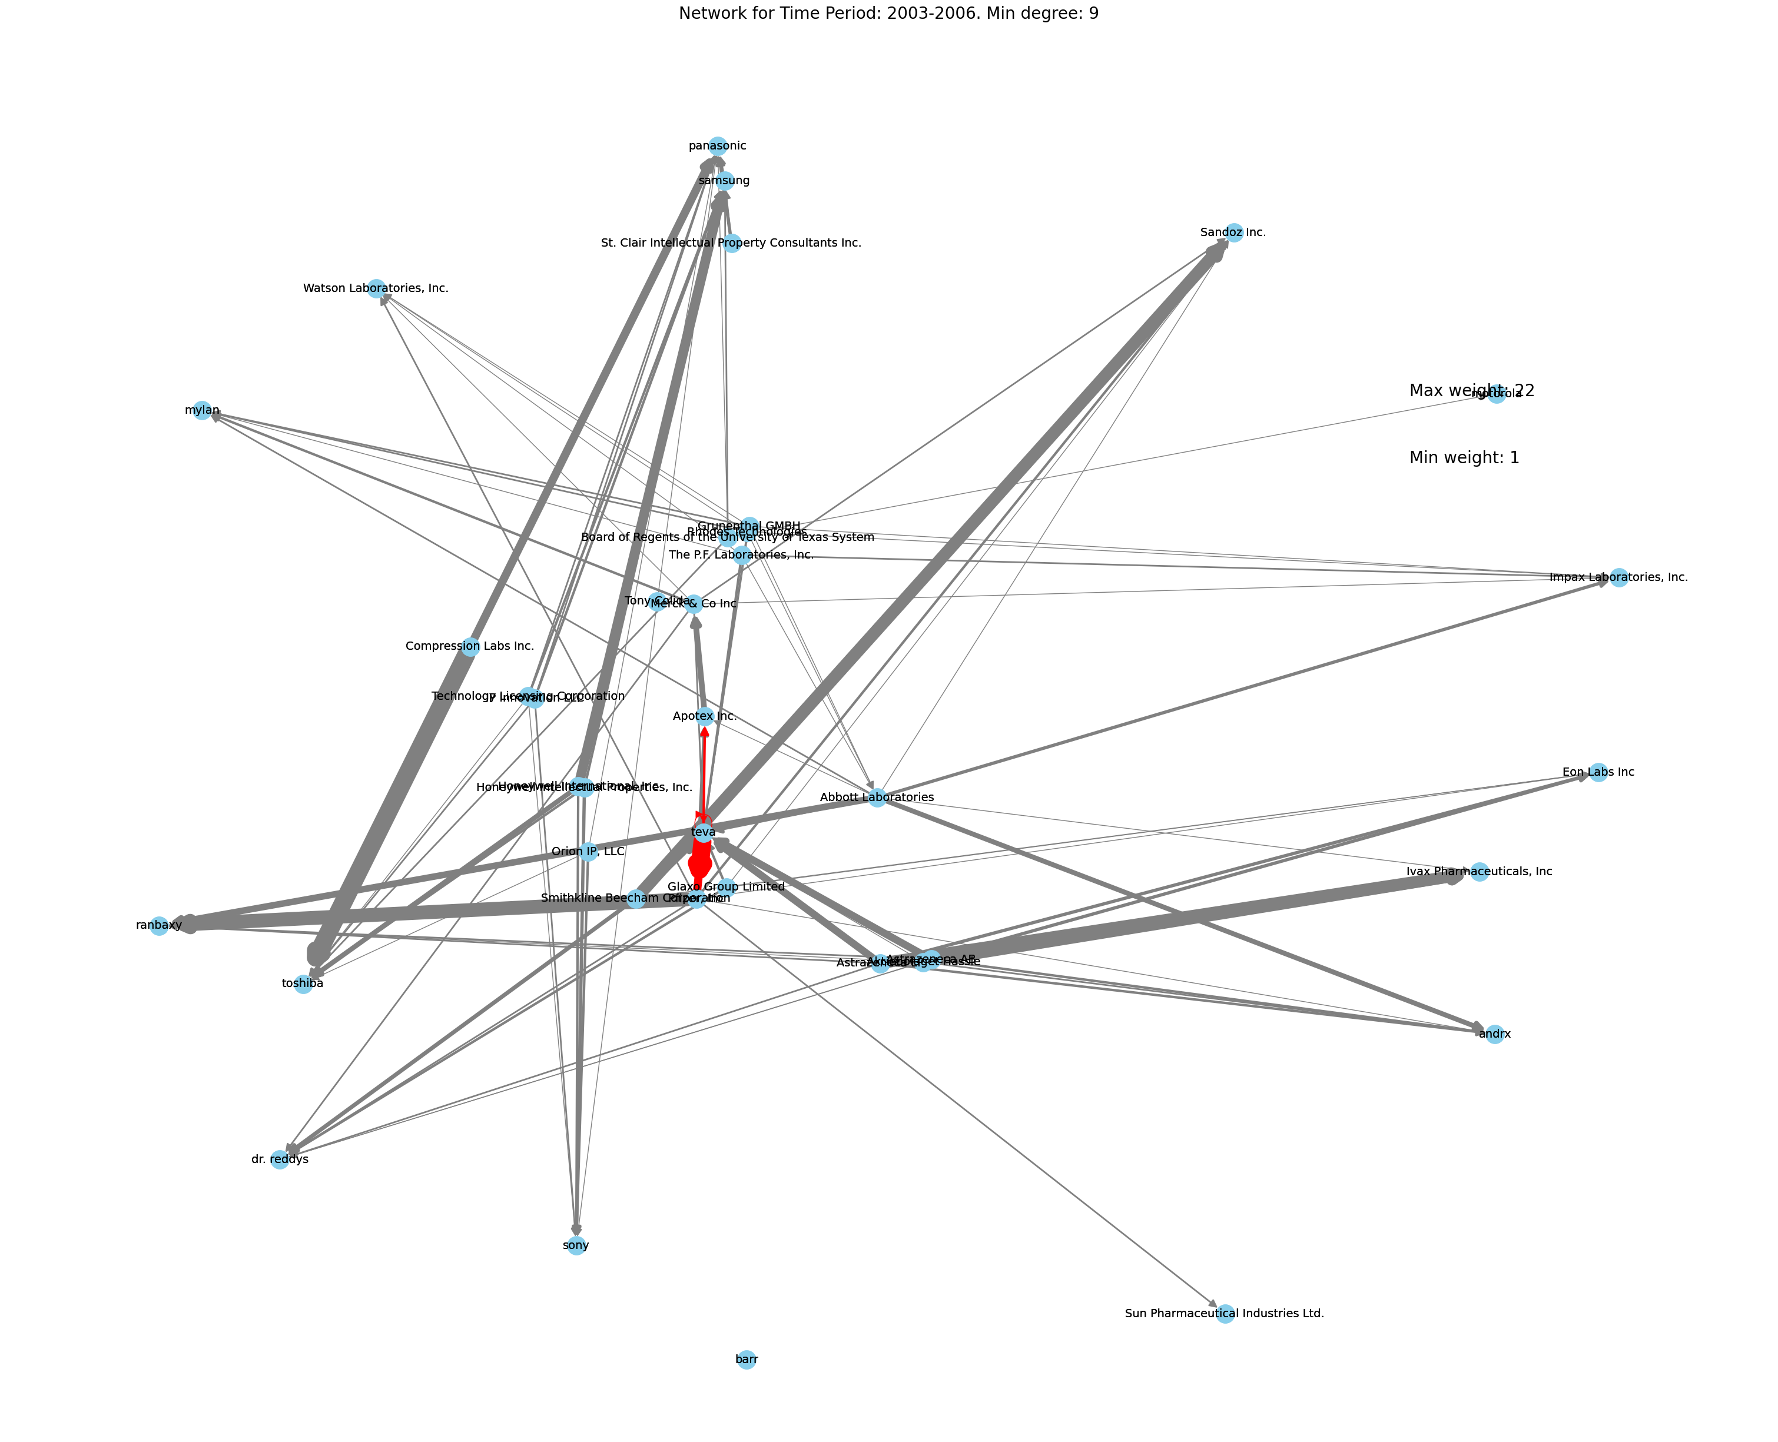
Visualization
Still the same clusters
+ counterclaims
Relatively the same volume
Jupyter notebook with the code and plots

Slide 9
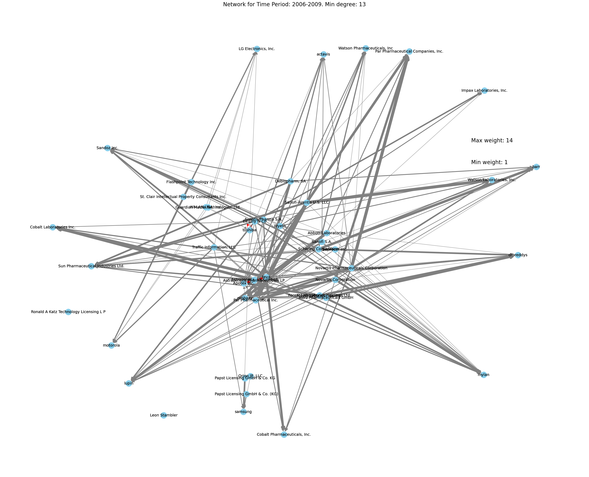
Visualization
Bigger volume, we increased threshold for min degree
More licensing companies
Jupyter notebook with the code and plots

Slide 10
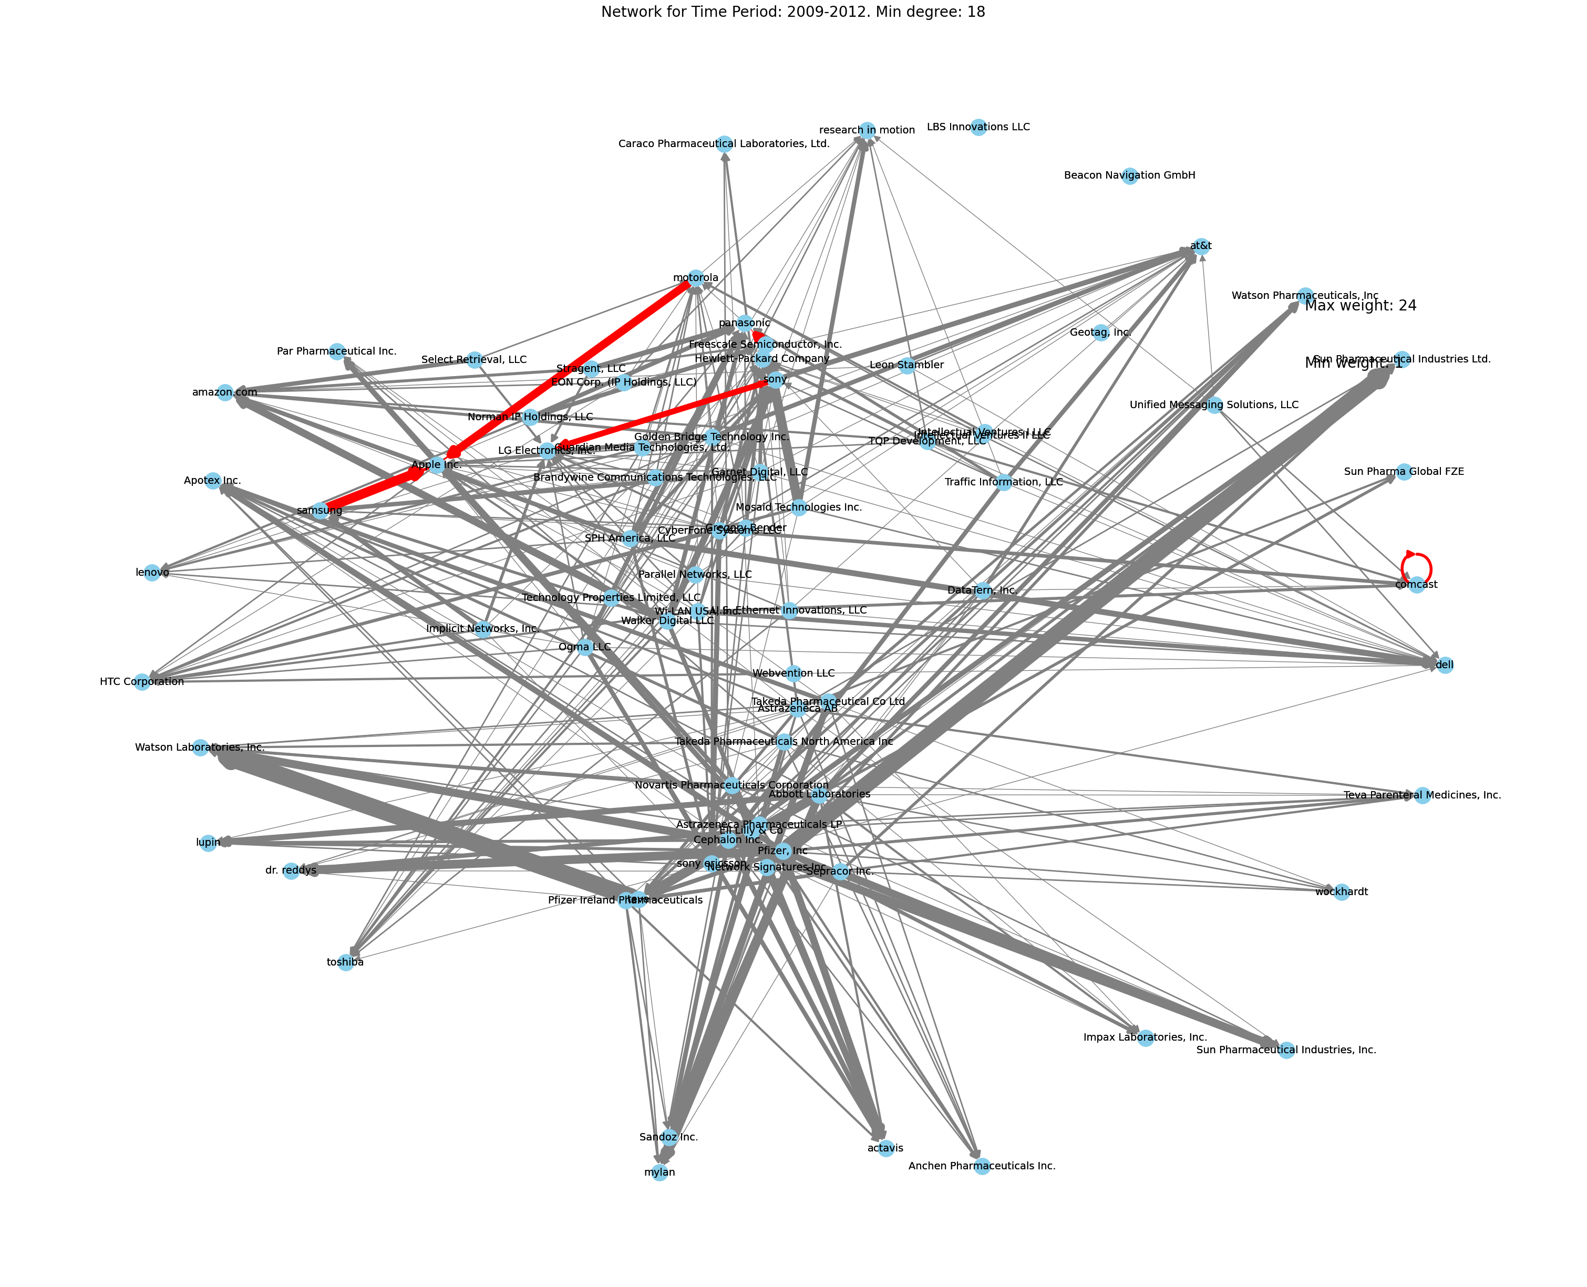
Visualization
Counterclaims between technology giants (Apple, Samsung, Motorola, LG, Sony)
Pharma and technology clusters are recognizable
Jupyter notebook with the code and plots

Slide 11
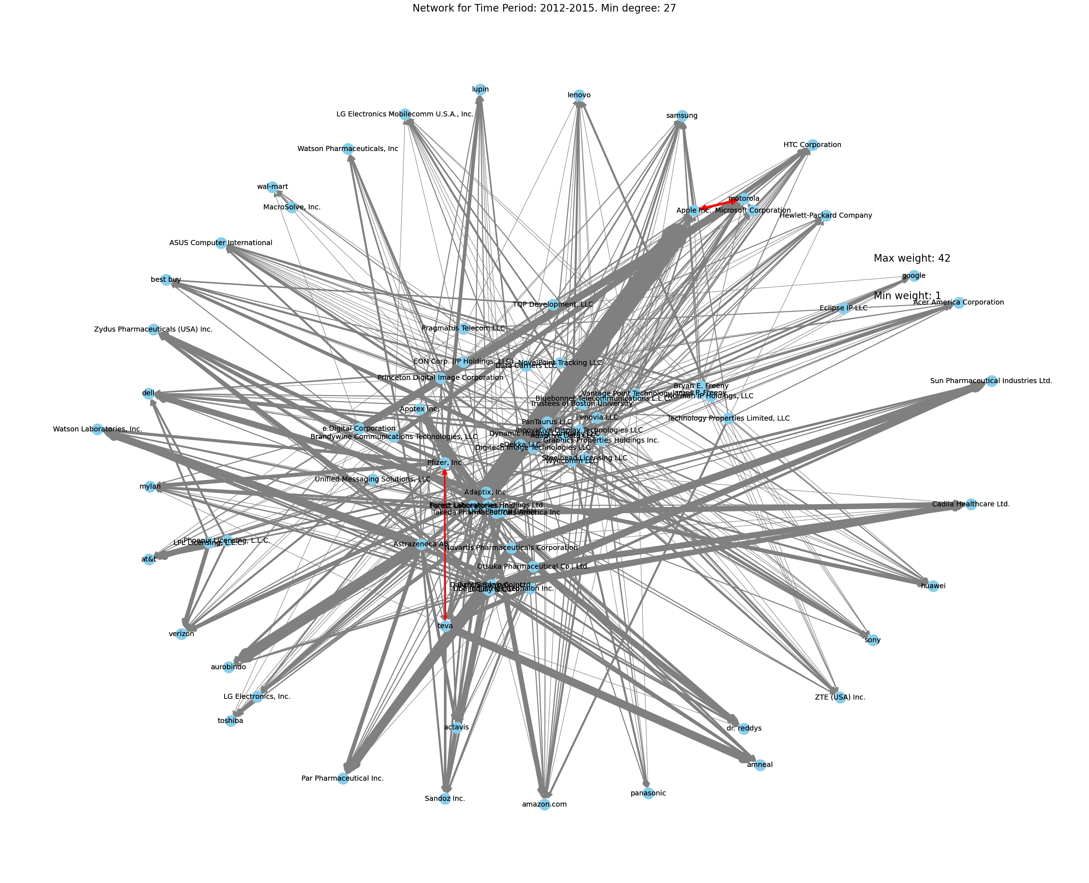
Visualization
Less counterclaims between technology giants (Apple vs Motorola)
Migration of companies from center (attackers) to borders and vice versa
Dramatic increase of cases volume (min degree 27)
Jupyter notebook with the code and plots

Slide 12
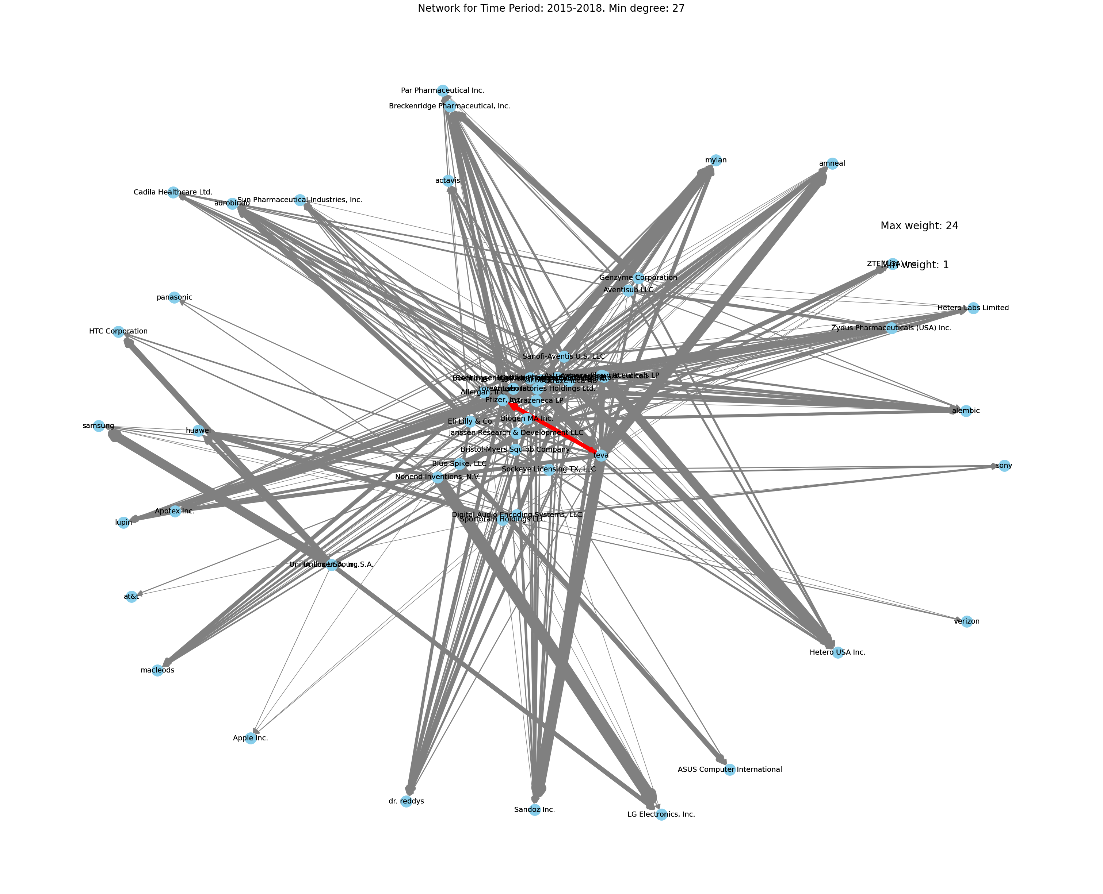
Visualization
No counterclaims between technology giants
Jupyter notebook with the code and plots

Slide 13
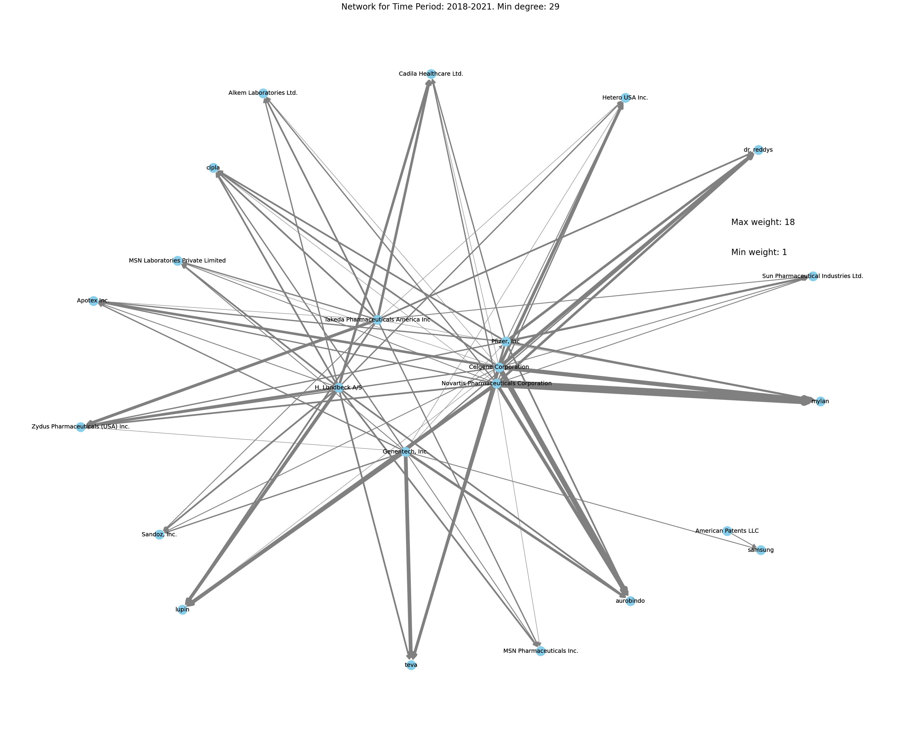
Visualization
Pfizer still in the center
It can indicate, that in pharma and technology clusters successful market position can lead to different places in such graph representation
Jupyter notebook with the code and plots

Slide 14
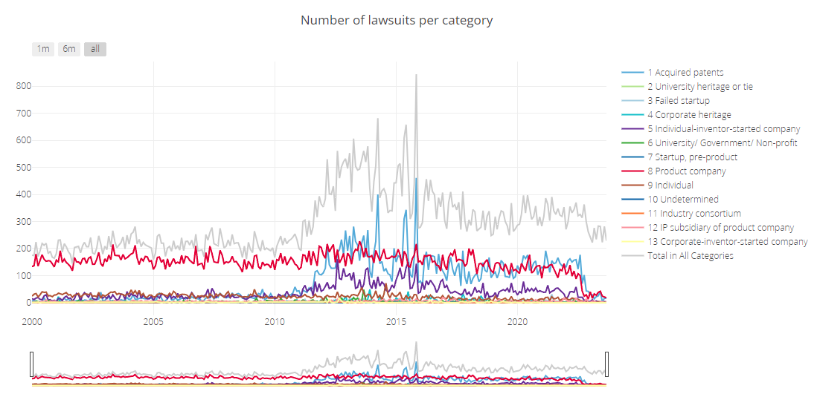
What next
-Investigate lawsuits categories (presented in data)
-Investigate dynamics between two companies
-Try dynamic visualization
https://npe.law.stanford.edu/

Slide 15
Thanks!

